Slide 1
Automobile Data Analysis
Student Name: Barath S P
Batch Number:DA394S39
Mentor Name: Jaya Pandey M

Slide 3
GENERAL INTRODUCTION
The automobile industry, also known as the automotive industry, encompasses a wide range of businesses and organizations involved in the design, development, manufacturing, marketing, and sale of motor vehicles.
It plays a vital role in the global economy, being one of the largest industries by revenue and a significant contributor to employment and technological innovation
Through the Given Data We are going to analyze the Automobile Market Analysis in the Project 1 and in Project 2 we are going to measure the Make ,Model and variant under the aspects of different Category like Mileage, Distance, Body type Etc.….

Slide 4
INTRODUCTION ON PROJECT 1:-
In the automotive industry, where the market is rapidly evolving, car manufacturers are facing a growing demand from eco-conscious drivers who prioritize fuel efficiency and safety alongside traditional performance metrics.
To meet these demands, companies are increasingly turning to data analytics to guide decision-making at every stage of production, from design to marketing.
The upcoming tasks will involve data exploration, analysis, and visualization to support decision-making.

Slide 5
OBJECTIVE:-
1.Data Cleaning and Pre Processing.
2.Impute the missing values.
3.Solving Business Related Questions.
4.Writing Interpretation for Each Task Individually.
5.Providing Conclusions to support Analysis for the Entire Project.
6.By using this analysing To Reduce The Carbon Emission Produced by the Car.

Slide 6
PROJECT REQUIREMENT
1:-Top 10 cars with the highest miles per litre or gallon
In This Task I have Identified MAHINDRA E2O PLUS Produced highest mileage per Litre or Gallon.
2:-Top 10 Cars With the Highest Mileage Per Gallon Based on Displacement.
In This Task I have Identified The Top 10 Car with Highest Mileage Based on High Displacement.
Displacement | Manufacturer | Model
1197 | Suzuki | Ignis
998 | Suzuki | Alto K10
1498 | Volkswagen | Polo
1248 | Tata | Bolt
2179 | Mahindra | Tuv300 Plus
1497 | Tata | Altroz
1198 | Mahindra | Kuv100 Nxt
999 | Renault | Kwid
1199 | Tata | Tiago
1364 | Toyota | Etios Liva

Slide 7
3:- Top 3 manufacture With the Highest Number of Cars of the HATCHBACK Body Type.
In This Task I have Identified Top 3 Manufacture Of Cars Of the HATCHBACK Body Type(i.e : MARUTI SUZUKI,HYUNDAI,TATA)
5:-Relationship Between
(i).Displacement and city Mileage
(ii)City Mileage and Fuel Tank Capacity
Negative correlation
Positive correlation

Slide 8
6:-IDENTIFY THE CAR WHICH IS BEST FOR ADVENTUOURS DRIVES.
After Filtering in the Raw Data ,Applying Median values to the Respective Blank columns Finally BMW 7 – SERIES is the Best Adventures Car Is best suited for Adventures Drives.
7:-Choosing a CAR for the family Usage based on Certain Criteria.
After Filtering in the Raw Data ,Applying Median values to the Respective Blank columns Finally MAHINDRA ALTOURS G- 4 is the Best Adventures Car Is best suited for Adventures Drives.
Row Labels | Max of Number_of_Airbags | Max of Height_ | Max of City_Mileage_km_litre | Max of Length_ | Max of Width_ | Max of Seating_Capacity
Mahindra | 9 | 1880 | 80 | 5118 | 1960 | 8
Row Labels | Max of Width_ | Max of Wheelbase | Max of Number_of_Airbags | Max of Length_ | Max of Height_ | Max of Ground_Clearance
Bmw | 2218 | 3210 | 10 | 5219 | 1805 | 498
7-Series | 2169 | 3210 | 8 | 5219 | 1481 | 152

Slide 9
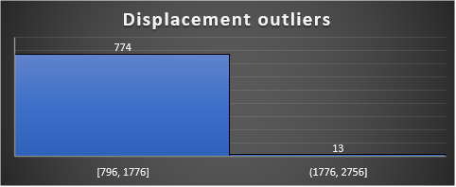
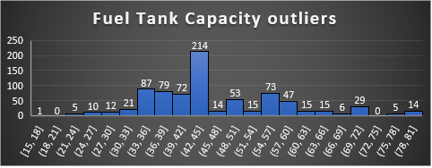
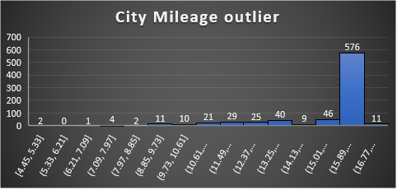
8:- Manufacture has decided to launch two types of Car
(i)Compact City Car (city Usage)
(ii)Family car (Highway Usage)
For City Usage:-
After the Blank Value Is filled with the median value ,we have to use the pivot table to sort and filter. After sorting Maruti Suzuki Baleno is the compact and suited for city usage.
After the Blank Value Is filled with the median value ,we have to use the pivot table to sort and filter. After sorting BMW X3 is the compact and suited for city usage
9:- OUTLIERS
Row Labels | Max of City_Mileage_km_litre | Max of Fuel_Tank_Capacity_litre | Max of Seating_Capacity | Max of Displacement
Suzuki | 25.17 | 80 | 8 | 2998
Row Labels | Max of City_Mileage_km_litre | Max of Seating_Capacity | Max of Fuel_Tank_Capacity_litre
Bmw | 18.9 | 7 | 93
X3 | 18.9 | 7 | 93

Slide 10
10:- Top 3 cars with the highest Number of Variant in the Hatchback category.
Top 3 Manufactures with the highest Number of Variant in the Sedan Category.
Top 3 Manufactures with the highest Number of Variant in the SUV Category.
11:-Most Popular car Body Type by Count from the Analysis of Task 2.
Row Labels | Count of Body_Type
Suzuki | 96
Hatchback | 96
Hyundai | 46
Hatchback | 46
Tata | 36
Hatchback | 36
Row Labels | Count of Body_Type
Suzuki | 163
Hatchback | 96
Sedan | 31
MPV | 17
SUV | 11
MUV | 4
Crossover | 4
Hyundai | 130
Hatchback | 46
Sedan | 44
SUV | 40
Row Labels | Count of Body_Type
Hyundai | 44
Sedan | 44
Skoda | 39
Sedan | 39
Toyota | 32
Sedan | 32
Row Labels | Count of Body_Type
Mahindra | 78
Hyundai | 40
Tata | 40

Slide 11
PROJECT – 2:-
As we move into this second phase, our focus shifts toward a more detailed analysis of fuel efficiency, driving patterns, and their relationship with carbon emissions.
The objective of this sprint is twofold: (1) further explore business questions to gather deeper insights into the diversity of car manufacturers and (2) analyze fuel efficiency to better understand the driving patterns across different car models.
This will help in identifying opportunities to reduce carbon emissions and support the development of more environmentally friendly models.

Slide 12
TASK&OUTPUTS
1:-(i)Top 2 Manufacture Who offer the widest range of car variants.
(ii):number of car variant under Each Body Type:
2:-Compare and calculate the varaitions between the city_mileage and displacement using method of dispersion of the following three manufactures.(i)Tata,(ii)Maruti suzuku ,(iii)Hyundai. After separating from the Data impute the median value for the respective blank space. Use the elements of Measure of dispersion compare the 3 Manufactures of Tata,Maruti_Suzuki and Hyundai.
MEASURE OF DISPERSION | TATA | MARUTI SUZUKI | HYUNDAI
RANGE | 13.32 | 28.4 | 10.9
INTERQUARTILE RANGE | 2.9 | 5.98 | 0.53
VARIANCE | 12.47 | 18.57 | 4.06
STANDARD DEVIATION | 3.53 | 4.31 | 2.01
MEAN | 17.71 | 18.99 | 16.50
COV | 20 | 23 | 12
Row Labels | Count of Body_Type
Suzuki | 163
Hatchback | 96
Sedan | 31
MPV | 17
SUV | 11
MUV | 4
Crossover | 4
Hyundai | 130
Hatchback | 46
Sedan | 44
SUV | 40

Slide 13
3:- Display and check how city Mileage and fuel tank capacity using scatter plot. Correlation is NEGATIVE CORRELATION.
4:- Display and check how displacement and fuel tank capacity using scatter plot .Correlation is POSITIVE CORRELATION

Slide 14
5B(B):- Correlation and scatter plot
5A:-

Slide 15
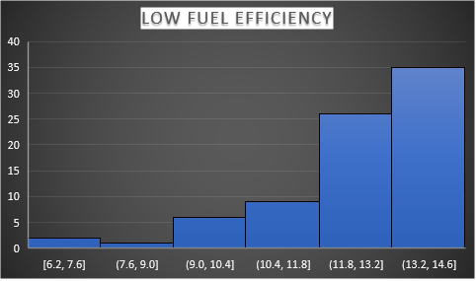
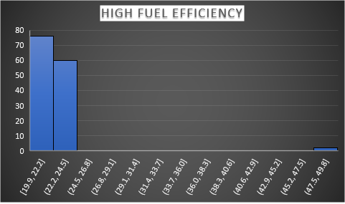
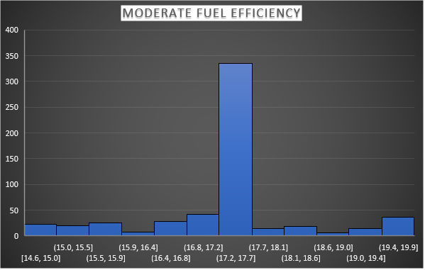
TASK 5C:-

Slide 16
SUMMARY
The Most Mileage Vehicle is Mahindra E20 Plus.
The Most Car is suited for city usage is MARUTI SUZUKI BALENO.
The most Car is suited for highway Mileage is BMW X3 .
The most suited car for Family car is MAHINDRA ALTROUS G4.
The most suited car for ADVENTOURS IS BMW 7 SERIES.
The Most Number of Car is produced for HATCHBACK category body Type is MARUTI SUZUKI .

Slide 17
The most manufacture which has number of variants is MARUTI SUZUKI.
Calculated and compared variations using the elements of Measure of dispersion of the three manufactures.
Plotted line chart for the comparison for city mileage and fuel tank capacity and displacement and fuel tank capacity
Plotted bar chart to compare average fuel efficiency with Make, Model, Fuel Types

Slide 18
THANK YOU🙏

